Slide 1

The Server-side JavaScript

Slide 2
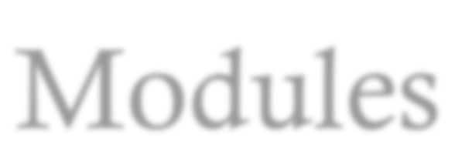


Modules
It is external library and available refer to use by require().
var circle =require('./circle.js'); console.log(circle.area(50));
// circle.js
var PI = Math.PI;
exports.area = function (r) {
return PI * r * r;
};
All libraries in node_modules no need to refer path ‘./’ or ‘../’.

Slide 3

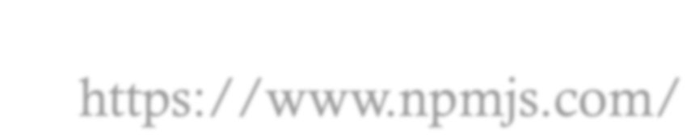

npm – Node Package Manager
npm is the package manager for javascript and more.
https://www.npmjs.com/
npm install moduleName -option

Slide 4
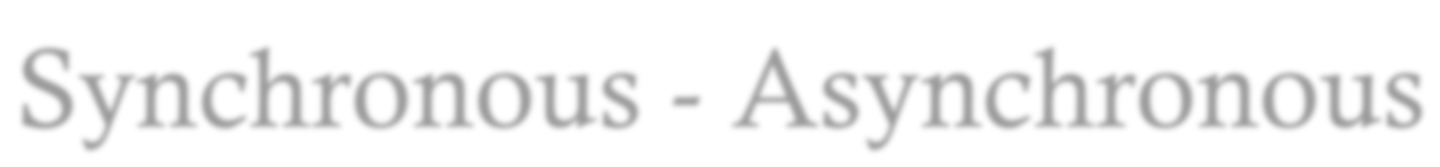
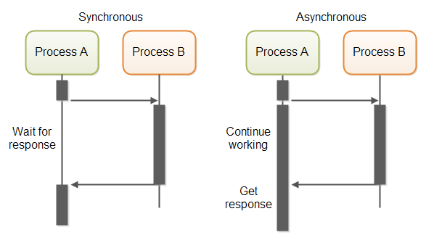
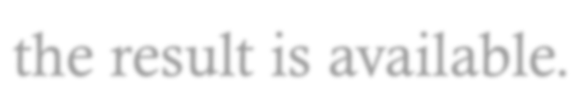
Synchronous - Asynchronous
Node.js runs on a single threaded event loop and leverages asynchronous calls for doing various things, like I/O operations. While other languages will send a database query and wait there for the result to come back, Node.js will not.
When you send a database query, Node.js will continue
executing the code that comes after it, then jump back when the result is available.

Slide 5
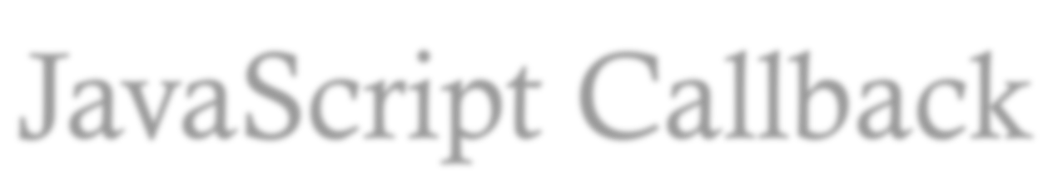
JavaScript Callback
var util var fs = function
= require('util'); require('fs'); readFile(str, callback){
var lines =[]; fs.readFile(str, function (err,
if (err) throw err;
lines.push(data); console.log(data.toString());
});
callback(lines);
data) {
}
var a, b ;
readFile('./20.txt', function(data){a=
data;});
readFile('./10.txt',function(data){b= data;}); util.log("a"+ a);
util.log("b" +b);

Slide 6
Core Module
Assertion Testing Buffer
C/C++ Addons Child Processes Cluster
Crypto Debugger DNS
Domain Events
File System HTTP/HTTPS
Net OS
Path Process Punycode
Query Strings REPL
Stream

Slide 7

Core Module#2
String Decoder Timers TLS/SSL TTY
UDP/Datagram URL
Utilities VM ZLIB

Slide 8

Assertion Testing
This module is used for writing unit tests for your applications, you can access it with require('assert’).
var assert = require('assert');
function add (a, b) {
return a + b;
}
var expected = add(1,2);
assert( expected === 4, 'one plus two is three');

Slide 9

Buffer
Pure JavaScript is Unicode friendly but not nice to binary data. When dealing with TCP streams or the file system, it's necessary to handle octet streams. Node has several strategies for manipulating, creating, and consuming octet streams.
buf = new Buffer(10); buf.write("abcdefghj", 0, "ascii"); console.log(buf.toString('base64')); buf = buf.slice(0,5); console.log(buf.toString('utf8'));

Slide 10
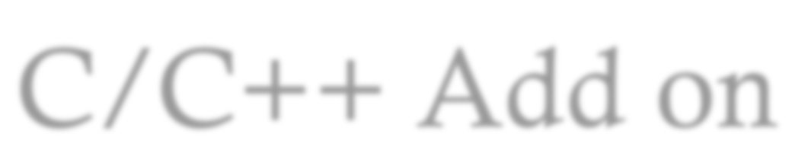




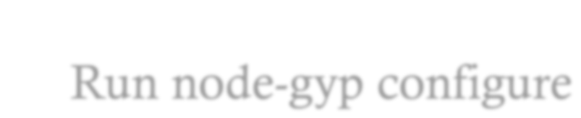

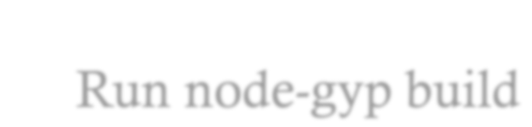

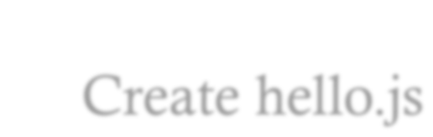

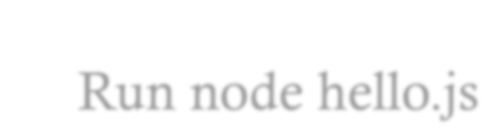

C/C++ Add on
Addons are dynamically linked shared objects. They can provide glue to C and C++ libraries.
Create hello.cc Create binding.gyp
Run node-gyp configure Run node-gyp build
Create hello.js Run node hello.js

Slide 11

Crypto
The crypto module offers a way of encapsulating secure credentials to be used as part of a secure HTTPS net or http connection.It also offers a set of wrappers for OpenSSL's hash, hmac, cipher, decipher, sign and verify methods.
var crypto = require('crypto');
var fs = require('fs');
var shasum = crypto.createHash('sha1'); var s = fs.ReadStream('file.txt'); s.on('data', function(d) {
shasum.update(d);
});
s.on('end', function() {
var d = shasum.digest('hex'); console.log(d + ' file.txt' );
});

Slide 12

Debugger
V8 comes with an extensive debugger which is accessible out- of-process via a simple TCP protocol. Node has a built-in client for this debugger. To use this, start Node with the debug argument; a prompt will appear:
//node debug debugger.js
for (var i=0;i<10;i++){ console.log(i);
}

Slide 13

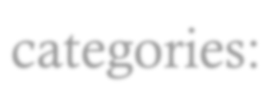

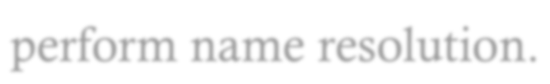
DNS
This module contains functions that belong to two different categories:
Functions that use the underlying operating system facilities to perform name resolution.
var dns = require('dns');
dns.lookup('www.google.com', function onLookup(err, addresses, family) {
console.log('addresses:', addresses);
});

Slide 14

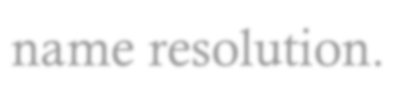
DNS#2
Functions that connect to an actual DNS server to perform name resolution.
var dns = require('dns'); dns.resolve4('www.google.com', function (err, addresses) {
if (err) throw err;
console.log('addresses: ' + JSON.stringify(addresses));
addresses.forEach(function (a) { dns.reverse(a, function (err, domains) {
if (err) {throw err;}
console.log('reverse for ' + a + ': ' + JSON.stringify(domains));
});
});
});

Slide 15

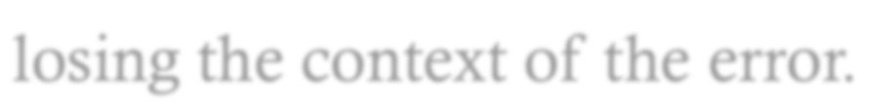
Domain
Domains provide a way to handle multiple different IO operations as a single group. If any of the event emitters or callbacks registered to a domain emit an error event, or throw an error, then the domain object will be notified, rather than losing the context of the error.

Slide 16

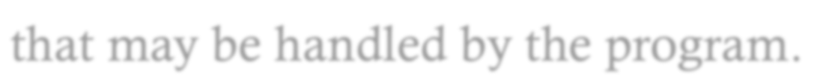
Events
Event is an action or occurrence detected by the program that may be handled by the program.
var events =require('events').EventEmitter;
var ee = new events(); ee.items = [1,2,3,4,5,6,7];
ee.on("changedItem", function () {
console.log("event has occured"); console.log("index:" + this.lastIndexChanged + "
value:" +this.items[this.lastIndexChanged]);
});
function setItem(index,value){ ee.items[index] = value;
ee.lastIndexChanged = index; ee.emit("changedItem");
}
setItem(3,"Hello World!");

Slide 17

File System
File I/O is provided by simple wrappers around standard POSIX functions. To use this module do require('fs'). All the methods have asynchronous and synchronous forms.
var fs = require('fs'); fs.writeFile('message.txt', 'Hello Node', function (err) {
if (err) throw err;
console.log('It\'s saved!');
});

Slide 18

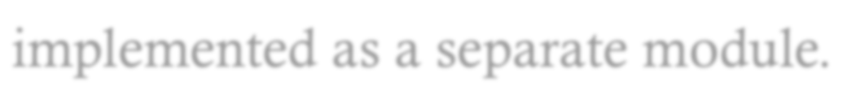
HTTPS
HTTPS is the HTTP protocol over TLS/SSL. In Node this is implemented as a separate module.
var https = require('https');
var fs = require('fs');
var options = {
key: fs.readFileSync('./localhost.key'), cert: fs.readFileSync('./localhost.cert')
};
https.createServer(options, function (req, res) { res.writeHead(200);
res.end("hello world\n");
}).listen(8000);

Slide 19

Net
Creates a new TCP server. The connectionListener argument is automatically set as a listener for the 'connection' event.options is an object with the following defaults:
var net = require('net');
var server = net.createServer(function(c)
{ //'connection' listener console.log('client connected'); c.on('end', function() {
console.log('client disconnected');
});
c.write('hello\r\n'); c.pipe(c);
});
server.listen(8124, function() { //'listening'
console.log('server bound');
});
listener

Slide 20

Net#2
//client
var net = require('net');
var client = net.connect({port: 8124},
function() { //'connect' listener
console.log('connected to server!'); client.write('world!\r\n');
});
client.on('data', function(data) { console.log(data.toString()); client.end();
});
client.on('end', function() { console.log('disconnected from
});
server');

Slide 21

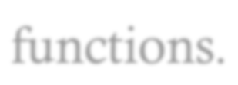
OS
Provides a few basic operating-system related utility functions.
var os = require('os'); console.log(os.hostname()); console.log(os.type()); console.log(os.platform()); console.log(os.arch()); console.log(os.release()); console.log(os.uptime()); console.log(os.loadavg());

Slide 22

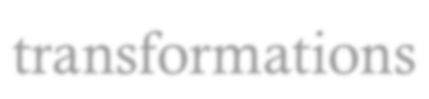
Path
This module contains utilities for handling and transforming file paths. Almost all these methods perform only string transformations
var path= require('path');
var result ="";
result+= path.normalize('/foo/bar//baz/asdf/quux/..'); result+="\n" + path.join('/foo', 'bar', 'baz/asdf', 'quux', '..');
result+="\n"+path.resolve('foo/bar', '/tmp/file/',
'..', 'a/../subfile'); console.log(result);

Slide 23

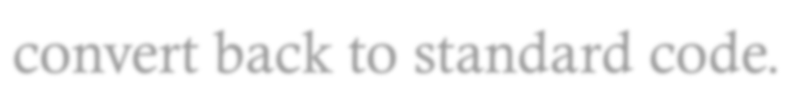
Punycode
Library for convert standard character code to readable or convert back to standard code.
var punycode = require('punycode'); console.log(punycode.decode('maana-pta')); // 'mañana' punycode.decode('--dqo34k'); // '☃-⌘'
// encode domain name parts
punycode.encode('mañana'); // 'maana-pta'
punycode.encode('☃-⌘'); // '--dqo34k'
// decode domain names punycode.toUnicode('xn--maana-pta.com'); // 'mañana.com'
punycode.toUnicode('xn----dqo34k.com'); // '☃-⌘.com'
// encode domain names
punycode.toASCII('mañana.com'); // 'xn--maana-pta.com'
punycode.toASCII('☃-⌘.com'); // 'xn----dqo34k.com'

Slide 24

Query String
This module provides utilities for dealing with query strings.
var querystring =require('querystring');
var result =querystring.stringify({ foo: 'bar', baz: ['qux', 'quux'], corge: '' });
result += "\n" +querystring.stringify({foo: 'bar', baz:
'qux'}, ';', ':');
result += "\n"
+querystring.parse('foo=bar&baz=qux&baz=quux&corge') console.log(result);

Slide 25

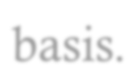
readline
To use this module, do require('readline'). Readline allows reading of a stream (such as process.stdin) on a line-by-line basis.
var readline = require('readline');
var rl = readline.createInterface({ input: process.stdin,
output: process.stdout
});
rl.question("What do you think of node.js? ",
function(answer) {
// TODO: Log the answer in a database
console.log("Thank you for your valuable feedback:", answer);
rl.close();
});

Slide 26

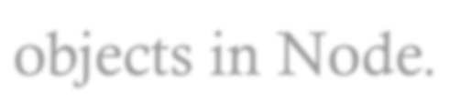
Stream
A stream is an abstract interface implemented by various objects in Node.
var fs = require('fs');
var zlib = require('zlib');
var var var
r = fs.createReadStream('file.txt'); z = zlib.createGzip();
w = fs.createWriteStream('file.txt.gz');
r.pipe(z).pipe(w);

Slide 27

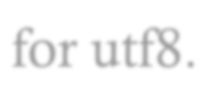
String Decoder
To use this module, do require('string_decoder'). StringDecoder decodes a buffer to a string. It is a simple interface to buffer.toString() but provides additional support for utf8.
var StringDecoder = require('string_decoder').StringDecoder; var decoder = new StringDecoder('utf8');
var cent = new Buffer([0xC2, 0xA2]); console.log(decoder.write(cent));
var euro = new Buffer([0xE2, 0x82, 0xAC]); console.log(decoder.write(euro));

Slide 28

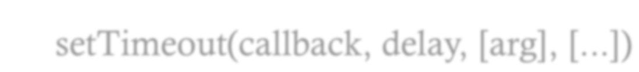

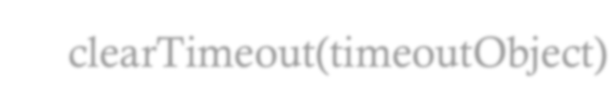

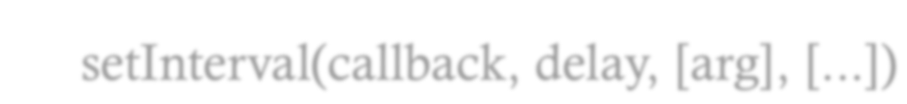

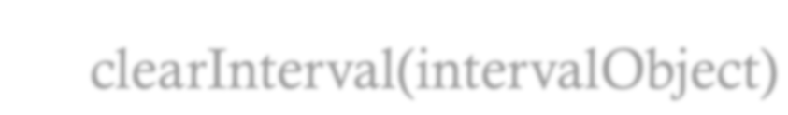

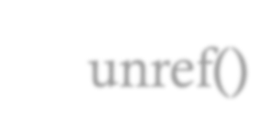

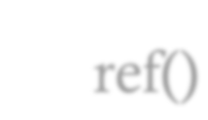

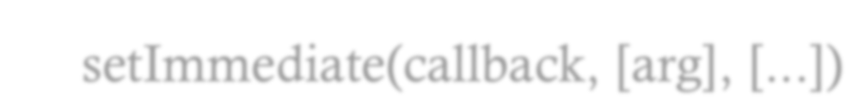

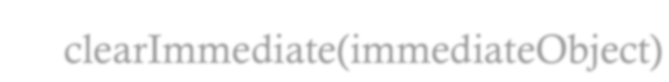

Timers
All of the timer functions are globals. setTimeout(callback, delay, [arg], [...]) clearTimeout(timeoutObject) setInterval(callback, delay, [arg], [...]) clearInterval(intervalObject)
unref() ref()
setImmediate(callback, [arg], [...]) clearImmediate(immediateObject)

Slide 29

UDP uses a simple connectionless transmission model with a minimum of protocol mechanism. It has no handshaking dialogues, and thus exposes any unreliability of the underlying network protocol to the user's program. There is no guarantee of delivery, ordering, or duplicate protection.
UDP
//Server
var dgram = require("dgram");
var server = dgram.createSocket("udp4"); server.on("error", function (err) {
console.log("server error:\n" + err.stack); server.close();
});
server.on("message", function (msg, rinfo) { console.log("server got: " + msg + " from " +
rinfo.address + ":" + rinfo.port);
});
server.on("listening", function () { var address = server.address(); console.log("server listening " +
address.address + ":" + address.port);
});
server.bind(41234);

Slide 30

UDP #2 Client
var dgram = var message var client
require('dgram');
= new Buffer("Some bytes");
= dgram.createSocket("udp4");
client.send(message,
0, message.length,
function(err, bytes)
41234, "localhost",
{
client.close();
});

Slide 31

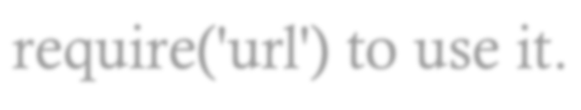
URL
This module has utilities for URL resolution and parsing. Call require('url') to use it.
var url =require('url');
var result =url.parse('http:// user:pass@host.com:8080/p/a/t/h? query=string#hash'); console.log(result);

Slide 32

Utilities
Utility Library help convert and validate format of value.
var util = require('util'); console.log(util.format('%s:%s', 'foo', 'bar', 'baz')); // 'foo:bar baz' console.log(util.format('{%j:%j}', 'name', 'pup'));
console.log(util.format('%d', 1, 2,3,"4")); util.debug('message on stderr');
console.log(util.isArray([])); console.log(util.isArray(new Array)); util.print(util.isArray({}));
util.log(util.isDate(new Date()));

Slide 33
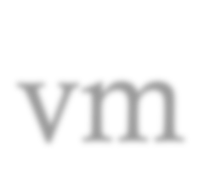
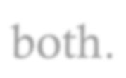
vm
In computing, a virtual machine (VM) is an emulation of a particular computer system. Virtual machines operate based on the computer architecture and functions of a real or hypothetical computer, and their implementations may involve specialized hardware, software, or a combination of both.
var util = require('util');
var vm = require('vm');
var myContext = { hello: "nobody"
}
vm.runInNewContext('hello = "world";', myContext);
util.log('Hello ' + myContext.hello);

Slide 34

Child Process
It is possible to stream data through a child's stdin, stdout, and stderr in a fully non-blocking way.
var exec = require('child_process').exec exec('ls', function (err, stdout, stderr){
if (err) {
console.log("child processes failed with error code: " +
err.code);
}
console.log(stdout);
});

Slide 35

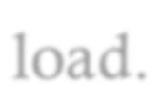
Cluster
A single instance of Node runs in a single thread. To take advantage of multi-core systems the user will sometimes want to launch a cluster of Node processes to handle the load.
var cluster = require('cluster');
if (cluster.isMaster) {
var numCPUs = require('os').cpus().length;
for (var i = 0; i < numCPUs; i++) { cluster.fork();
}
Object.keys(cluster.workers).forEach(function(id) { console.log(cluster.workers[id].process.pid);
});
}

Slide 36
MySQL – for database
//step -1 for package.json file
npm init --y
//Step-2 install packages
npm install --save mysql
//Step-3 import mysql module
const mysql = require('mysql');
//Step-4 connect mysql database
const connection = mysql.createConnection({
host: 'localhost',
user: 'root',
password: '1234567'
});

Slide 37
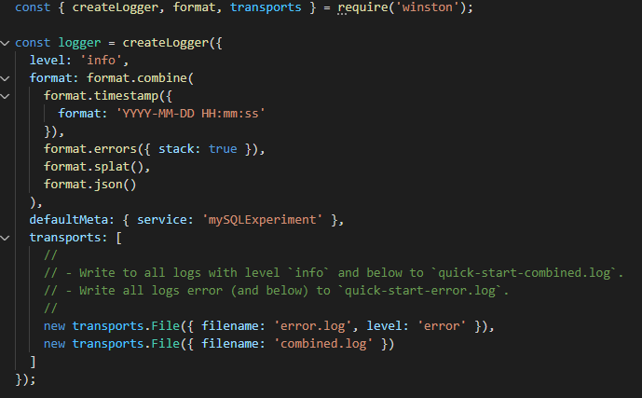
Winston – for logging
//step -1 for package.json file
npm init --y
//Step-2 install packages
npm install --save winston

